Slide 1
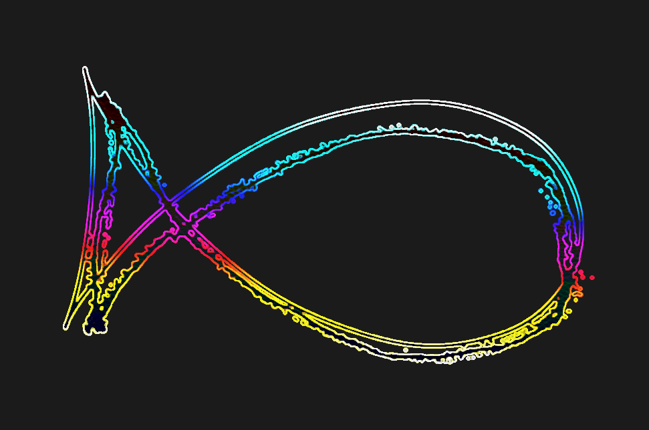
Optimizing Acoustophoretic Volumetric Displays for Accurate Rendering of Levitated Particles: A Data-Driven Approach
Presenter: Nimisha Satyaprasad Vernekar
Supervised by: Viktorija Paneva & Arthur Flieg
Reviewer 1: Prof. Dr. Jörg Müller
Reviewer 2: Viktorija Paneva
Serious Games AI8 University of Bayreuth, SS 2024

Slide 2
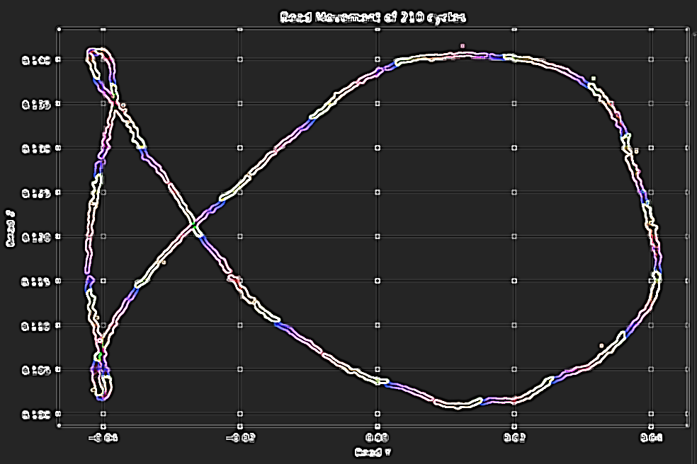
OUTLINE
AGENDA
Introduction
Problem Statement
Literature Review
Methodology
Hypothesis Testing
Results
Discussion
Limitations and Future Work

Slide 3
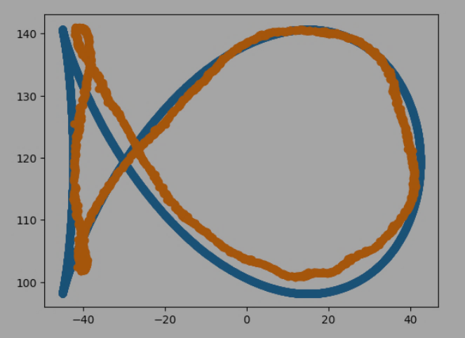

Context
Core Problem
Current Gaps
Research Question
Impact
P A R T I C L E D Y N A M I C S C H A L L E N G E S
Background and Motivation

Slide 4
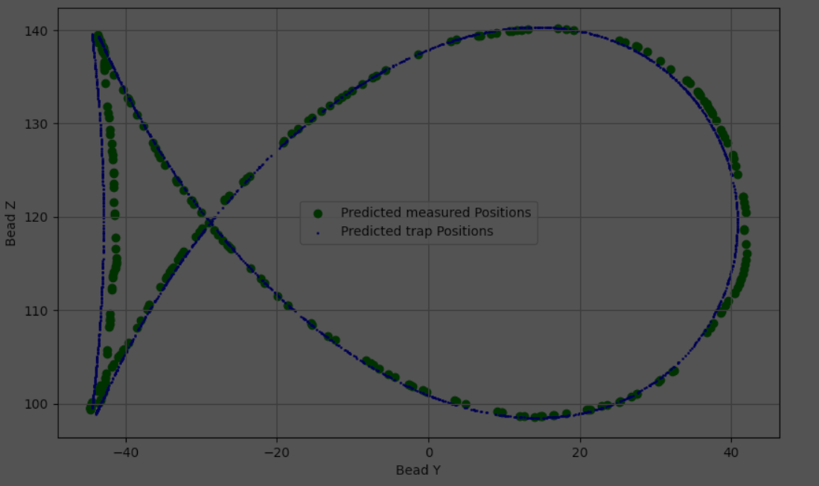
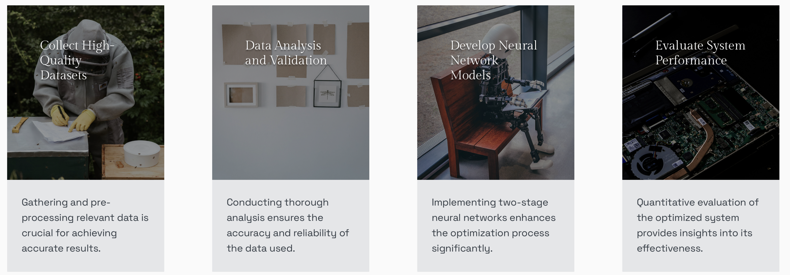
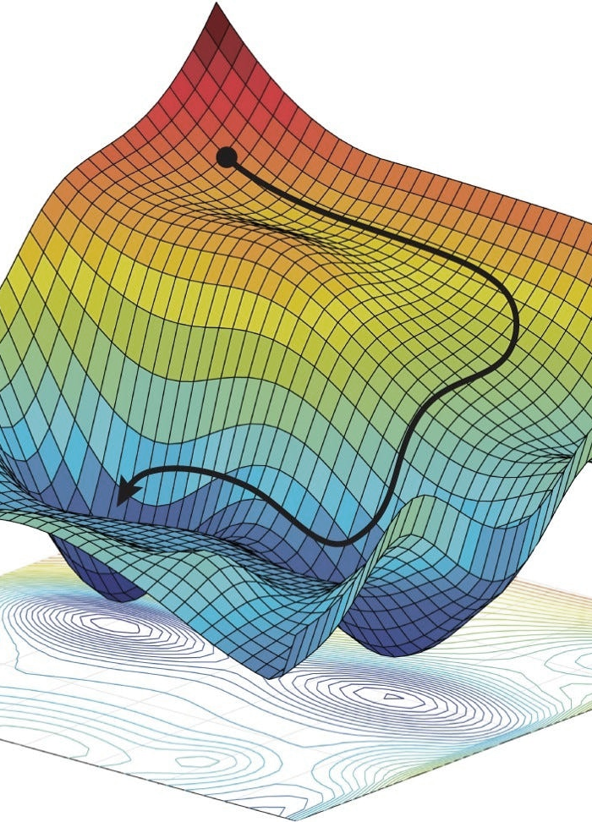
R E S E A R C H G O A L S
Research Objectives

Slide 5
CURRENT GAP
Literature Review
Study (Author, Year) | Method Used | Key Findings | Advantages | Limitations | How My Research Advances the Field
Marston et al. (2015) | Standing Wave Levitation | Single-axis particle levitation and manipulation | Simple and effective for small particles | Limited to single-axis control; not suitable for complex shapes | Enables precise multi-axis control for complex shapes.
Hirayama et al. (2019) | Phased Array Control | 3D volumetric display using phased arrays | High precision for complex 3D shapes | Complex calibration required | Improves precision with data scaling and custom function, reducing deviations.
Marzo et al. (2017) | Holographic Acoustic Tweezers | Dynamic control of multiple particles | Can control multiple particles simultaneously | High computational cost; particle interference issues | Introduces scalable models optimized for dynamic control, improving computational efficiency.
Baudoin et al. (2020) | Acoustic Vortex Beams | Trapping and rotation using vortex beams | Rotational control of particles | Limited scalability; challenging in small devices | Extends to precise manipulation of complex trajectories, beyond simple vortex control.
Zhang et al. (2021) | Machine Learning-Enhanced Control | ML models improve tracking and positioning | Adaptive control; reduces manual calibration | Requires large datasets; model accuracy limitations | Introduces a two-stage neural network with custom cost functions for better adaptability and precision in dynamic scenarios.

Slide 6
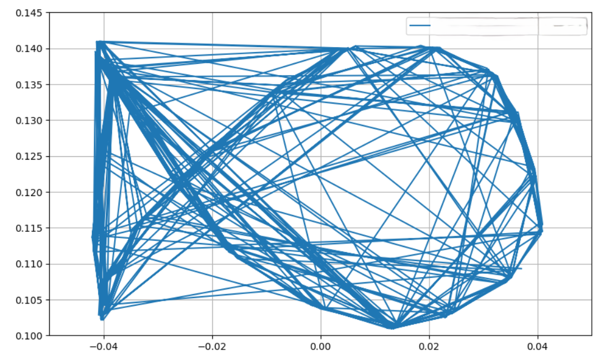
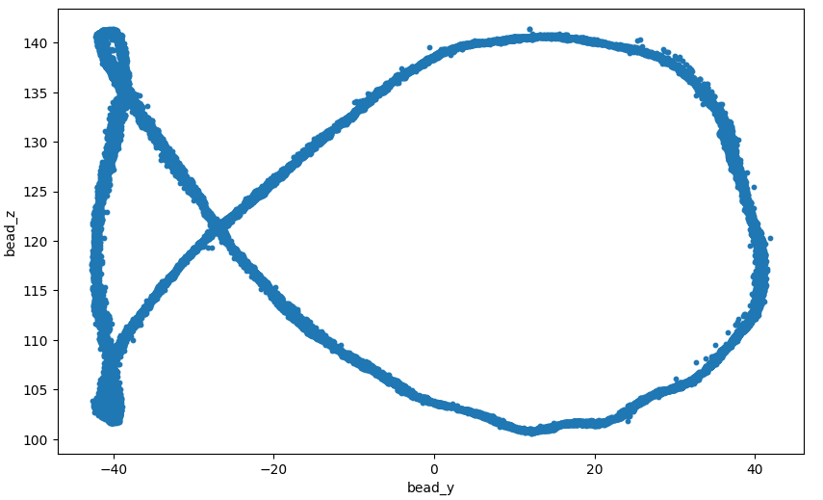
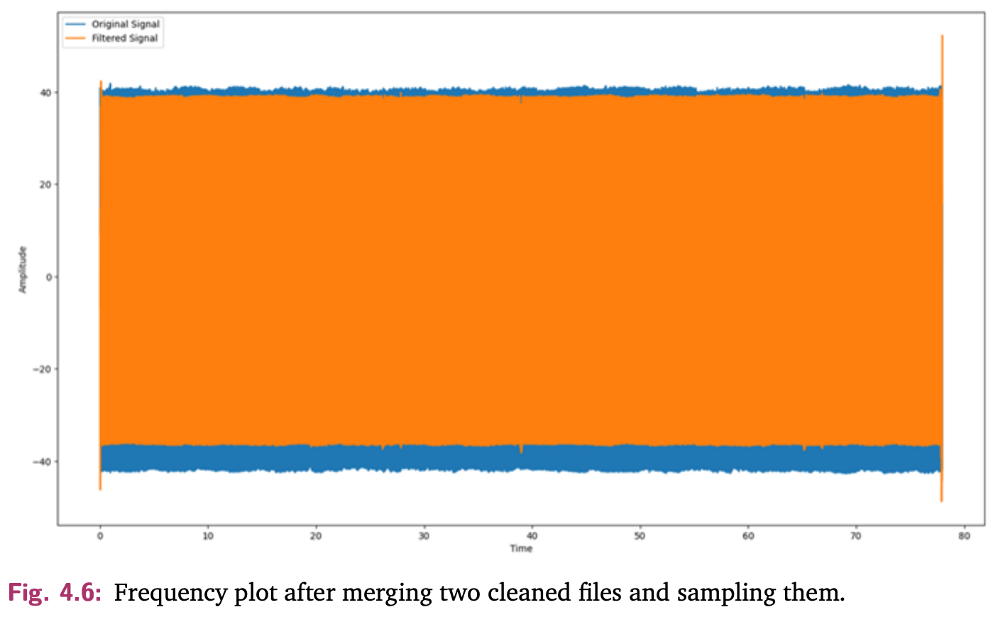
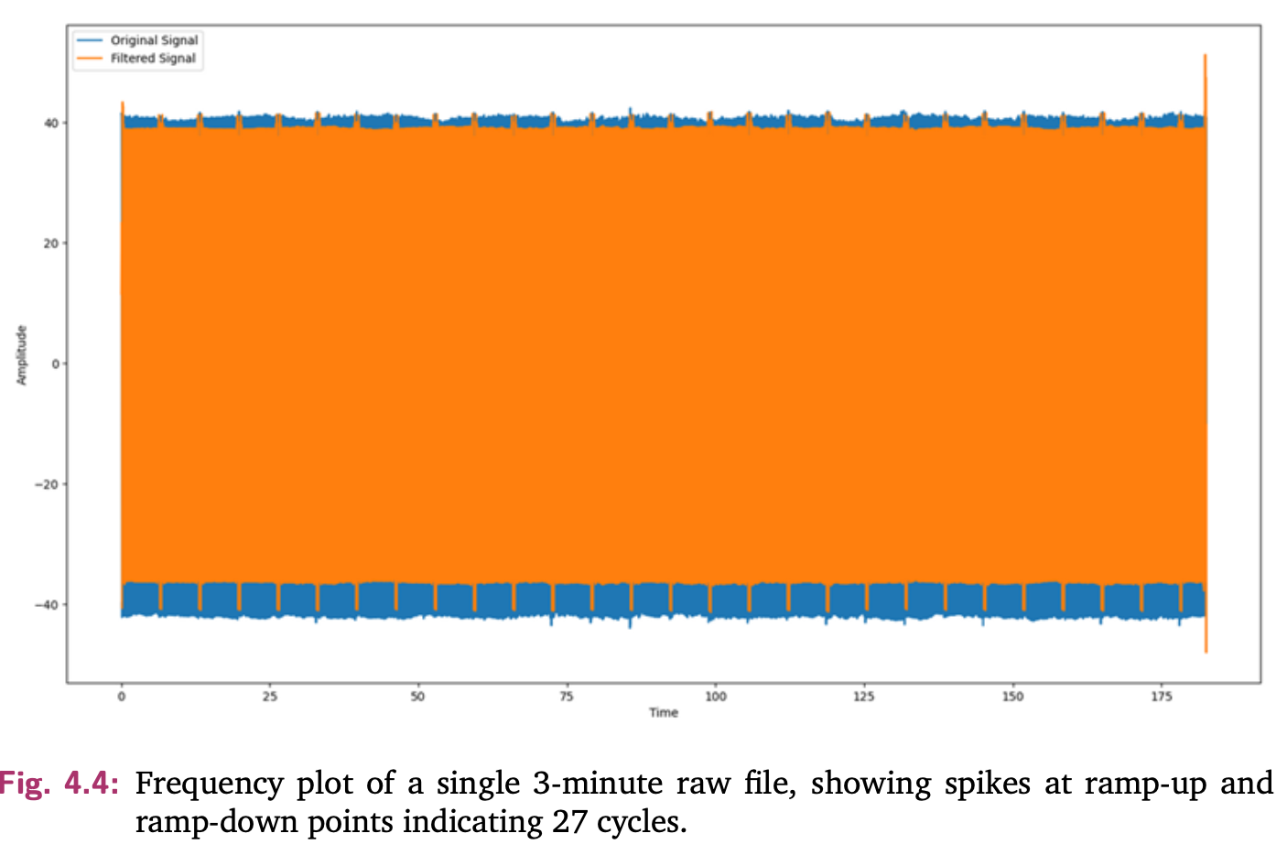
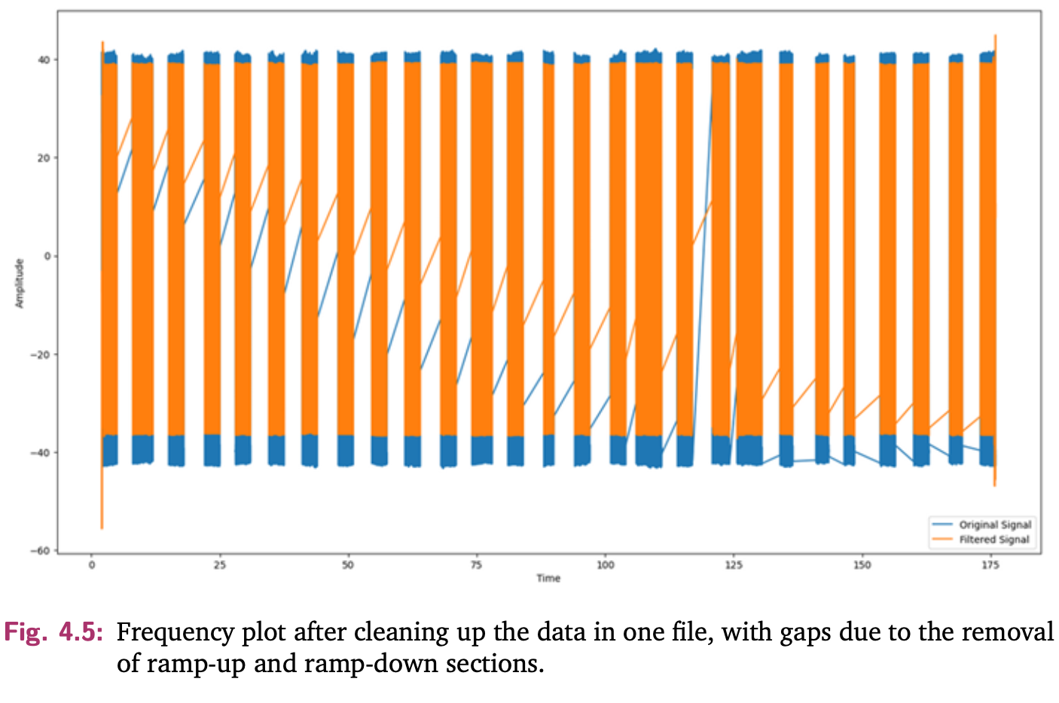
DATA ACQUISITION
Dataset Analysis and
Preparation
Shape Selection
Fourier Analysis and Data Cleaning
Cleaned file
Plot of bead_y vs bead_z (in m)
Plot of bead_y vs bead_z in mm

Slide 7
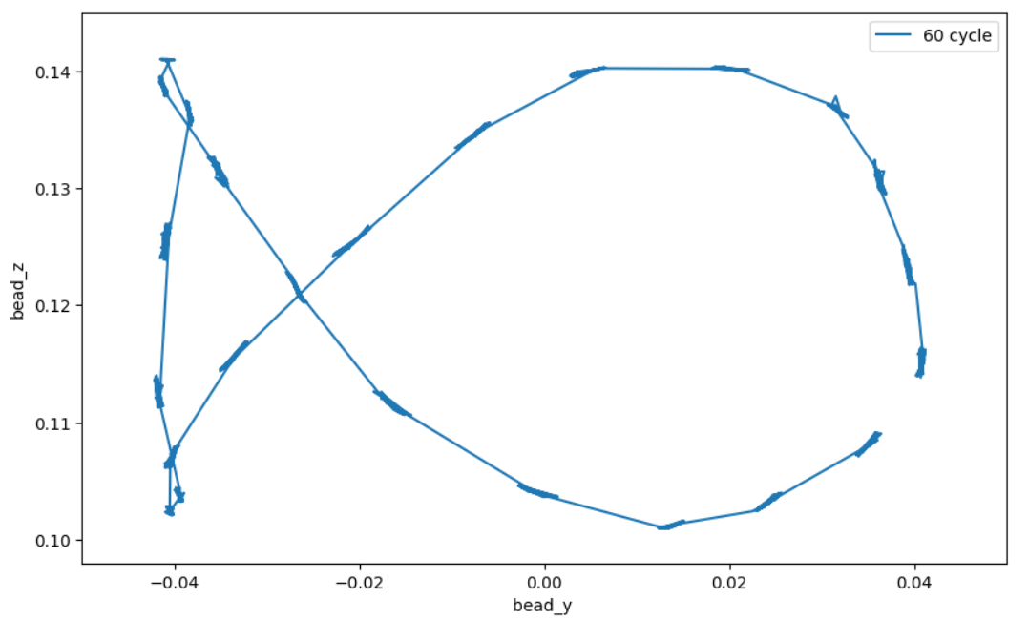
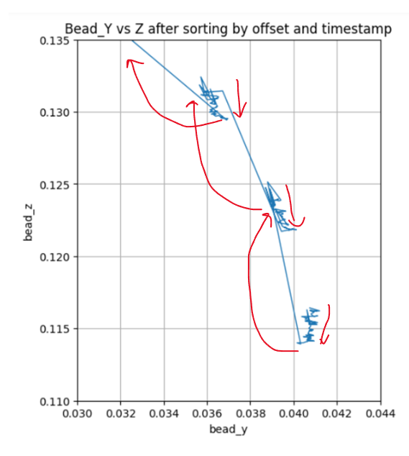
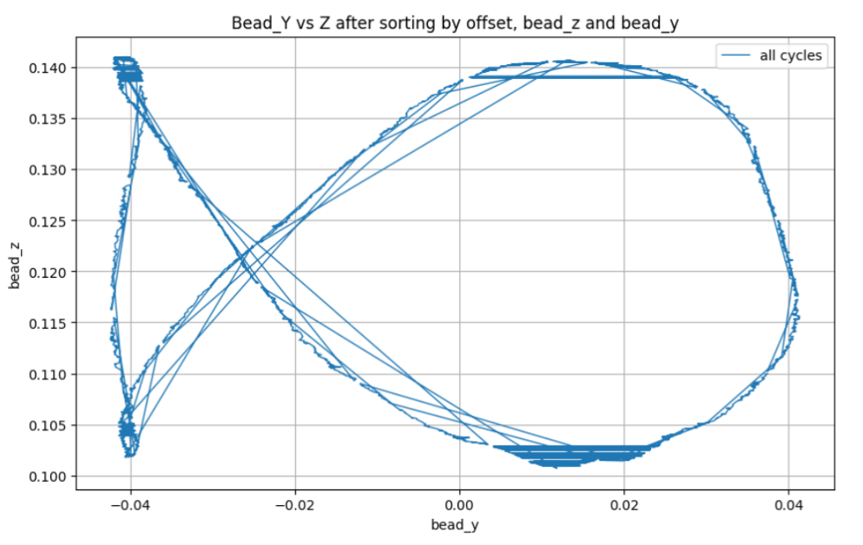
DATA curation
Dataset Creation
Plot of bead_y vs bead_z (in m)

Slide 8
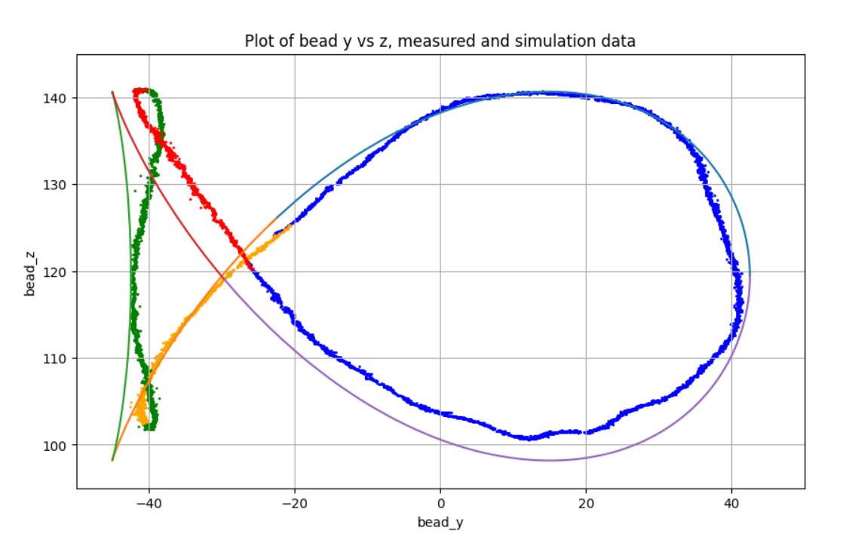
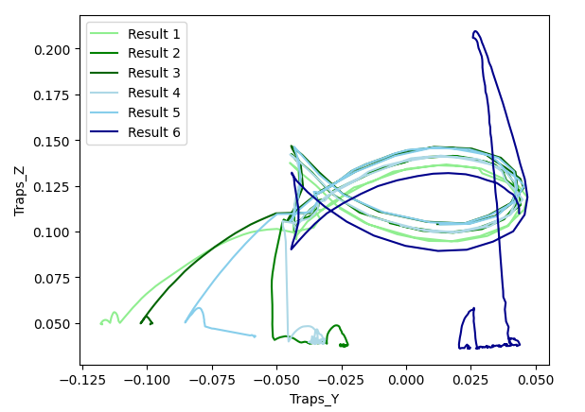
THETA TO THE RESCUE
Introduction of Theta and Selection Algorithm
Plot of measured data(orange) and nearest points from simulated data(blue) in mm
Plot of Trap Positions to verify the curated dataset
Selection Algorithm:
For every point on the measured dataset (y, z coordinates),
we need to find the corresponding closest point (Euclidean distance) on the
Simulated (reference) path

Slide 9
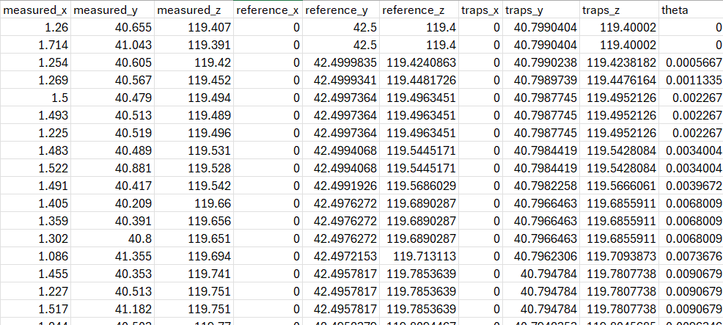
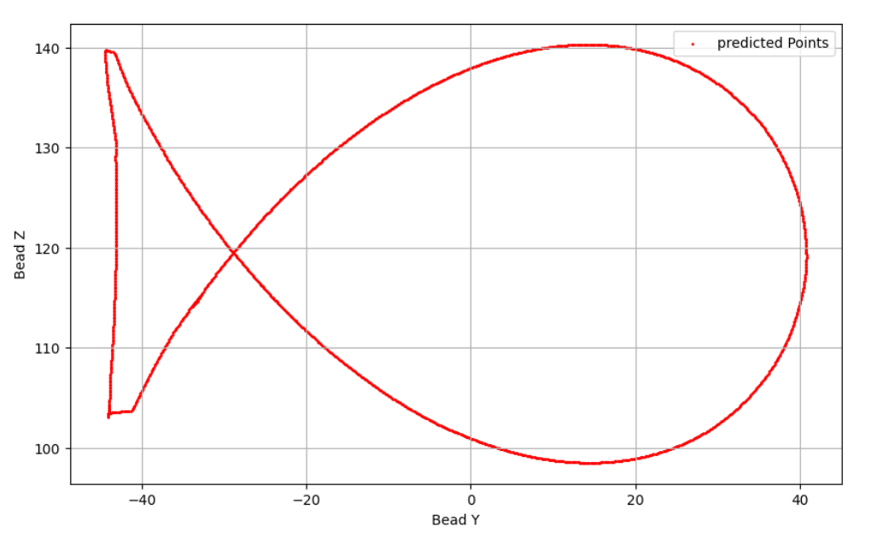
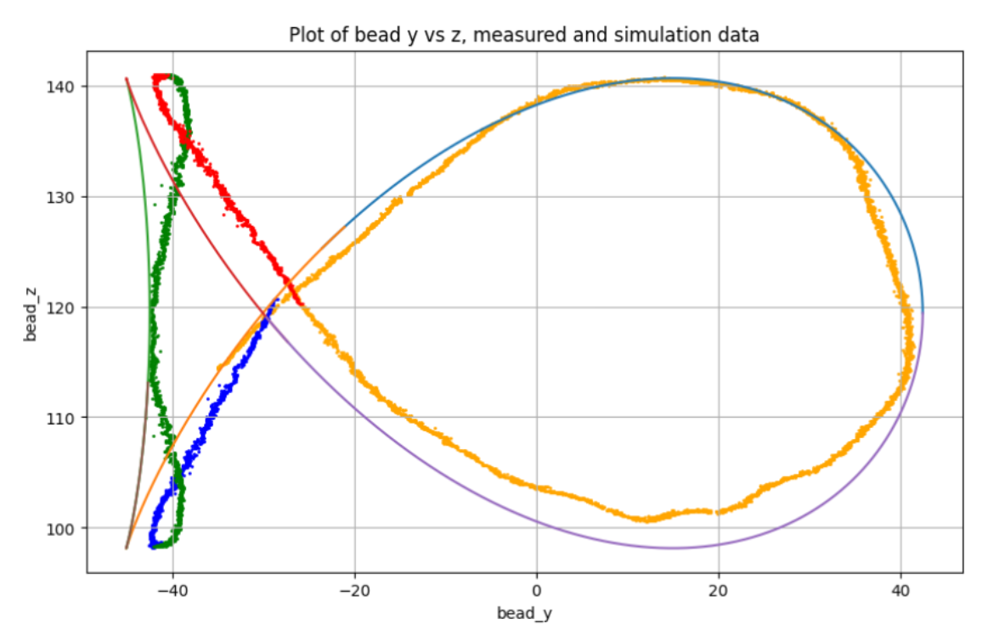
roadblock
Tail disjoint Problem
Plot of Predicted measured points
Plot of measured and simulated data (mirrored tail loop)

Slide 10
N E U R A L N E T W O R K M E T H O D O L O G Y
Methodology
Neural Network Model 1: (Prediction)
Map current trap positions and theta to measured positions.
Neural Network Model 2: (Optimization)
Optimize trap positions to match measured with simulated positions.
Trap Positions
Optimized Trap Positions
Measured Positions
Theta
Theta
Theta
LSTM layer
Dense layers
LSTM layer
Dense layers
64 Units
64 Units

Slide 11
Hypothesis (H1): Neural network models significantly reduce the deviation between simulated and measured particle positions in acoustophoretic volumetric displays, improving the accuracy and efficiency of particle manipulation.
Null Hypothesis (H0): No significant reduction in deviation is observed with neural network models.
Evaluation Metrics:
Mean Squared Error (MSE)
Mean Absolute Error (MAE)
R-squared (R²)
Plausibility check
Hypothesis Testing

Slide 12
Prediction model
Map current trap positions and theta to measured positions.
Model 1

Slide 13
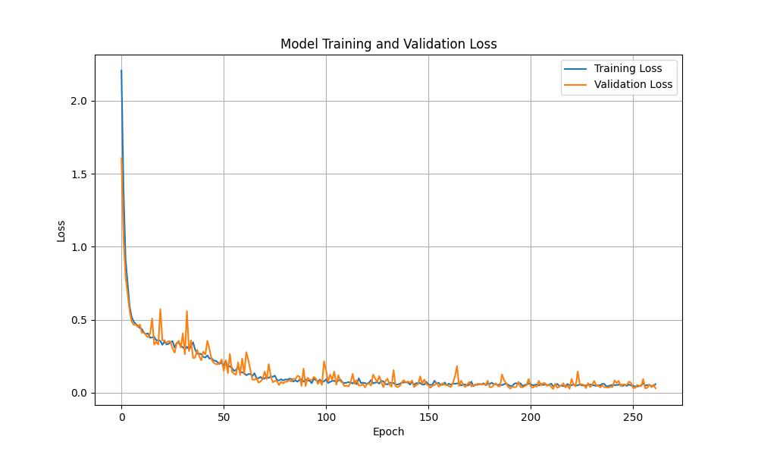
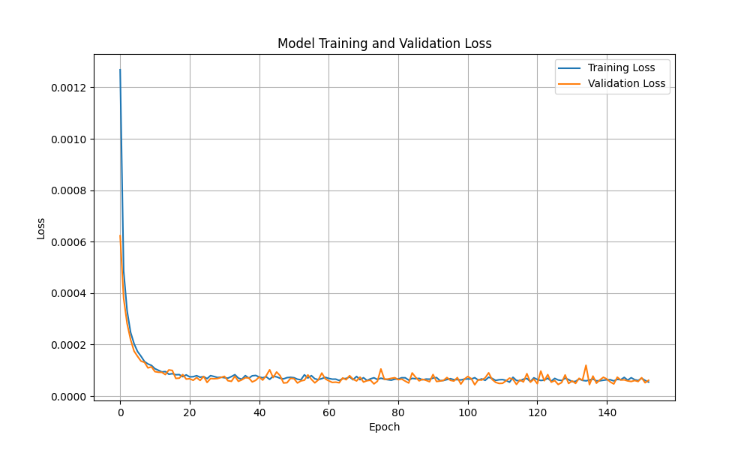
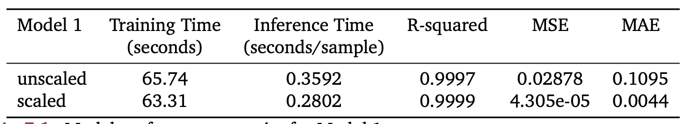
Prediction model
Map current trap positions and theta to measured positions.
Model 1
Unscaled
Scaled

Slide 14
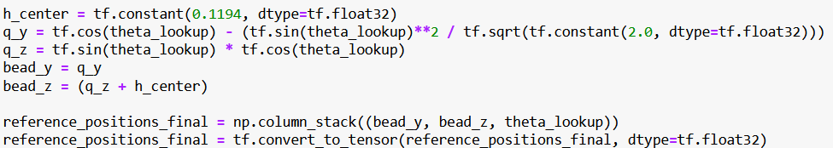
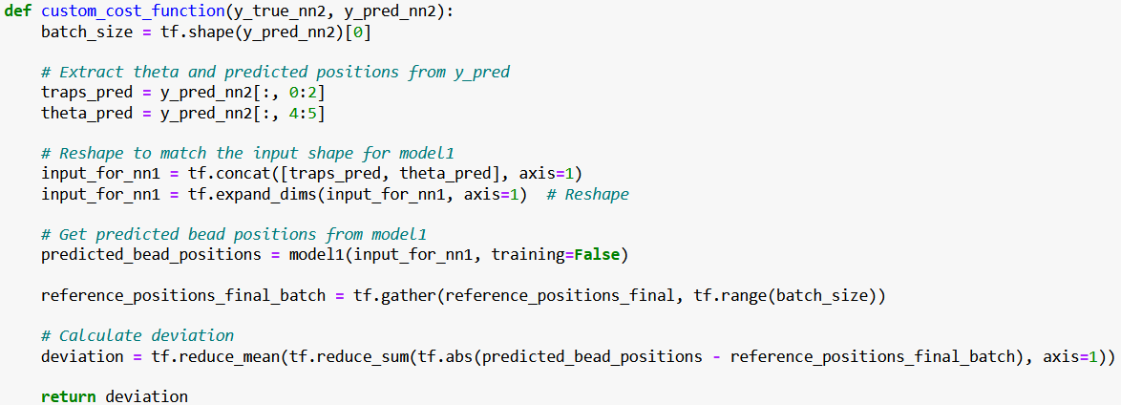
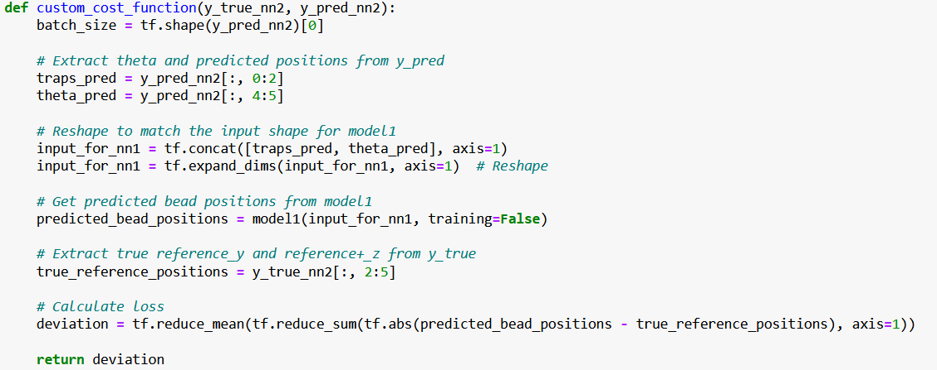
Optimize trap positions to match measured with simulated positions.
Custom Cost Function:
Optimization model
Model 2
Baseline – reference positions from dataset
Static Theta Static Reference – reference positions from theta and formulae
Static Theta Dynamic Reference – reference positions from theta and formulae but calculated inside the cost function

Slide 15
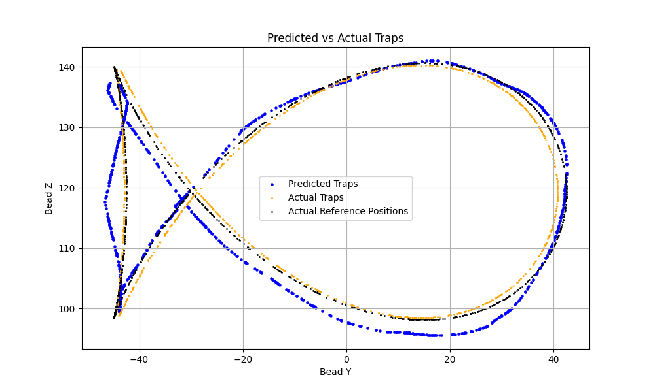
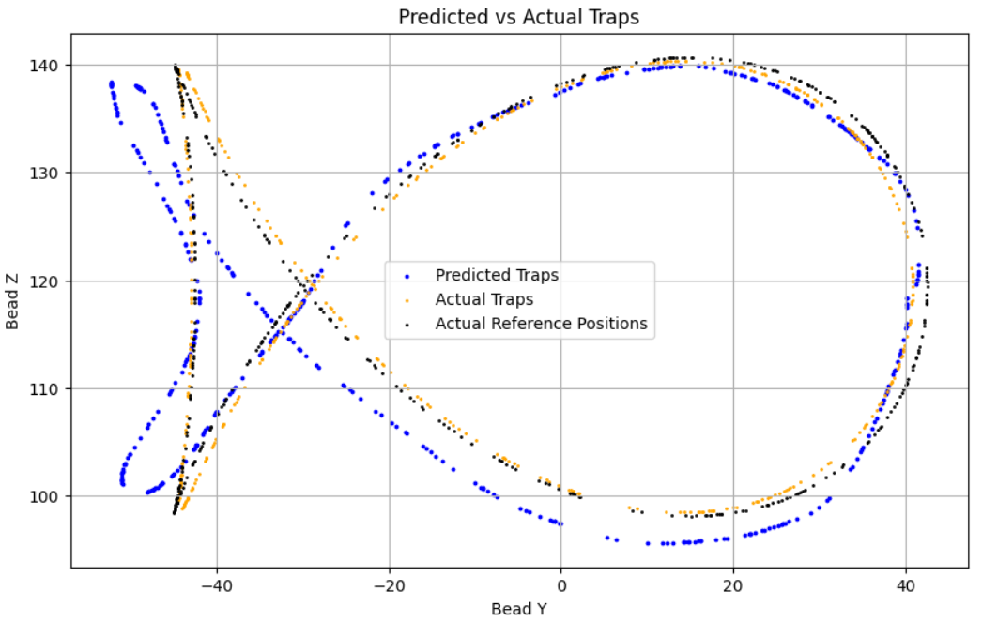
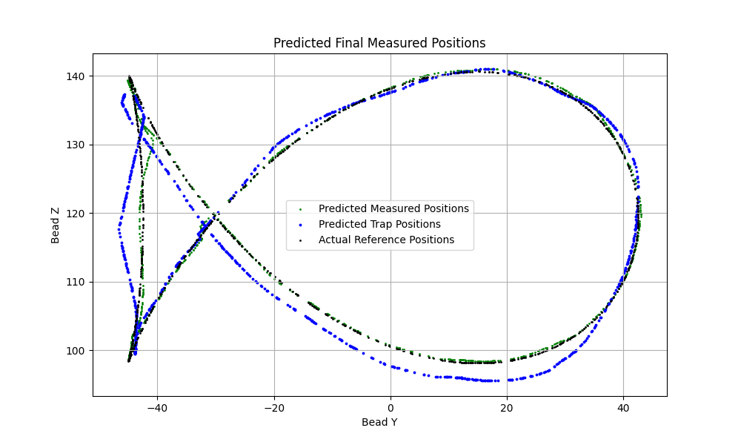
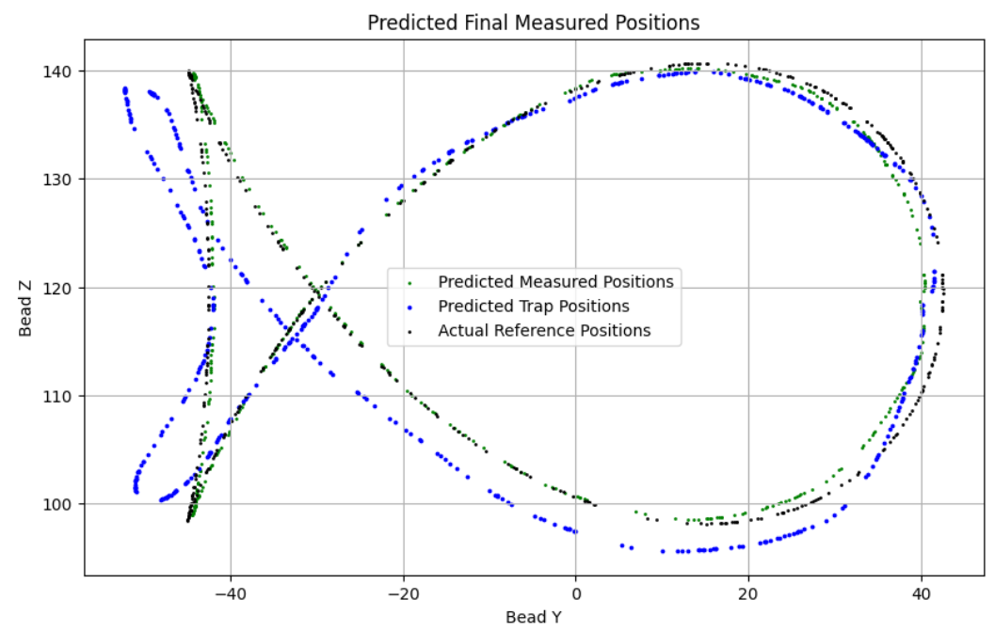
BASELINE MODEL vs SCALED BASELINE MODEL
0.9913
4.3908
1.4693
R²
MSE
MAE
0.9900
0.0100
0.0739
0.9994
0.2997
0.3818
R²
MSE
MAE
0.9999
6.5e-05
0.0051

Slide 16
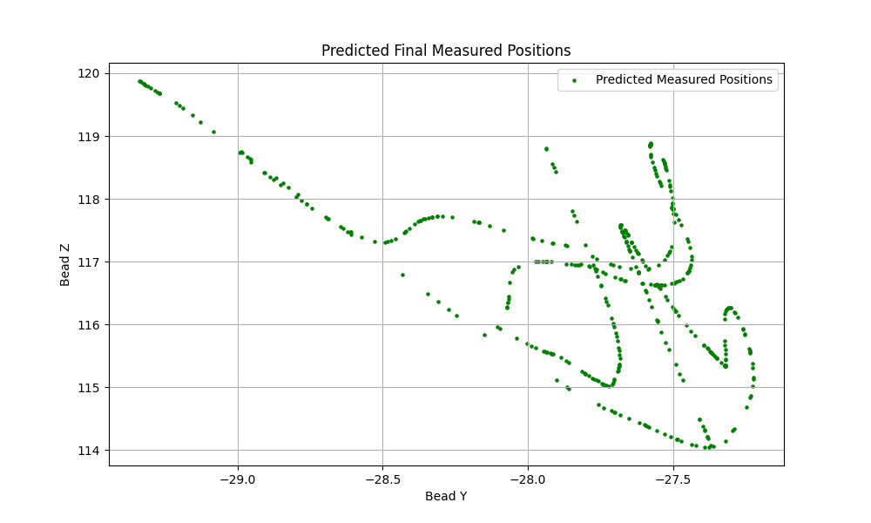
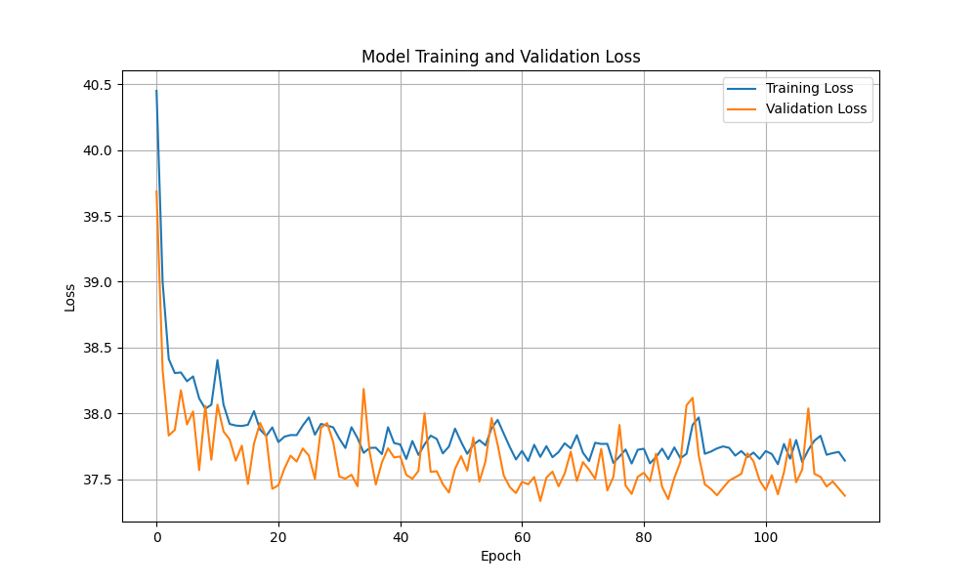
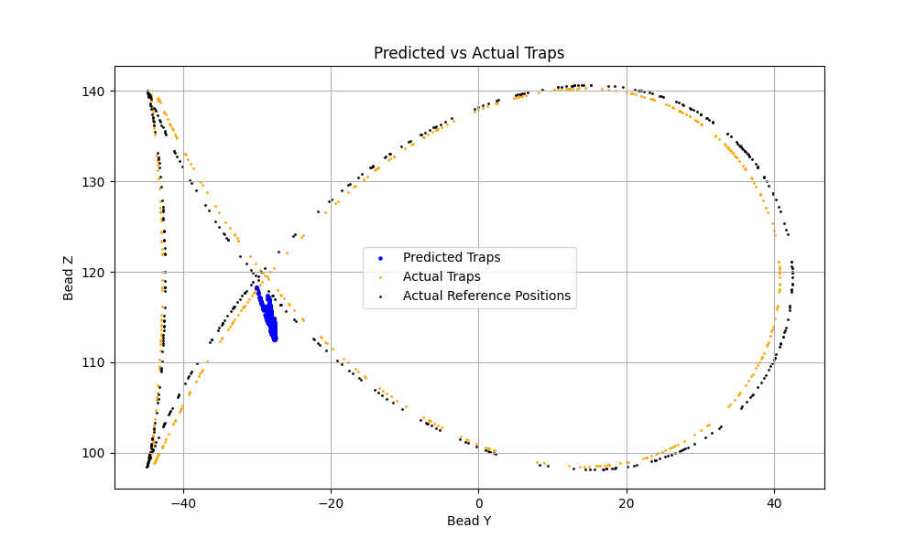
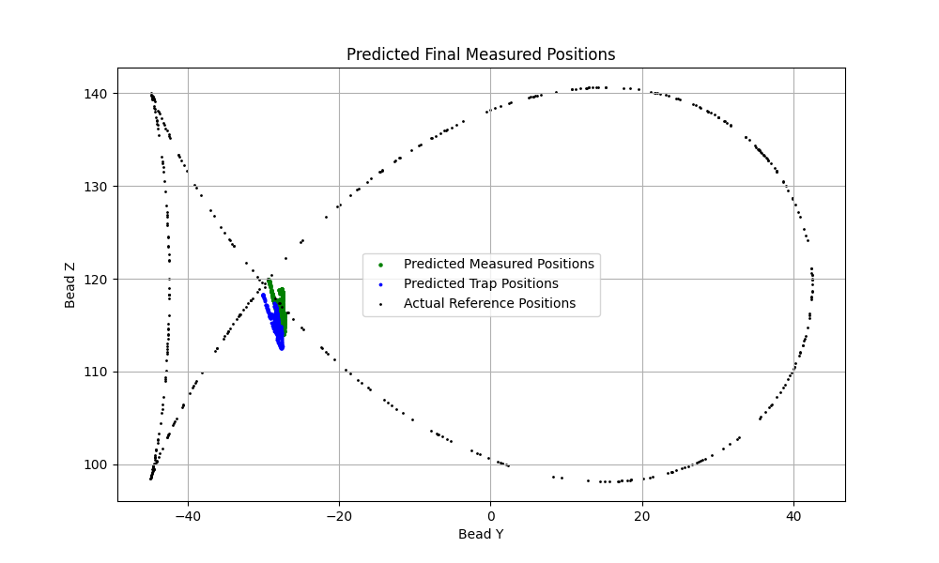
STATIC THETA STATIC REFERENCE MODEL (STSR)
Predicted Traps
Predicted Measured points
R²
MSE
MAE
-0.2303
797.348
21.3077
R²
MSE
MAE
-2834.53
819.981
21.6672

Slide 17
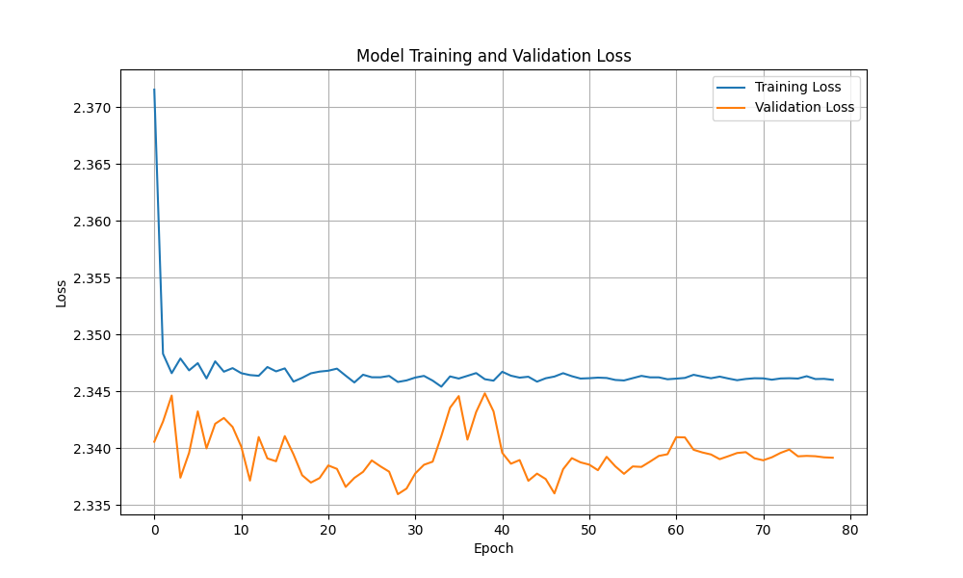
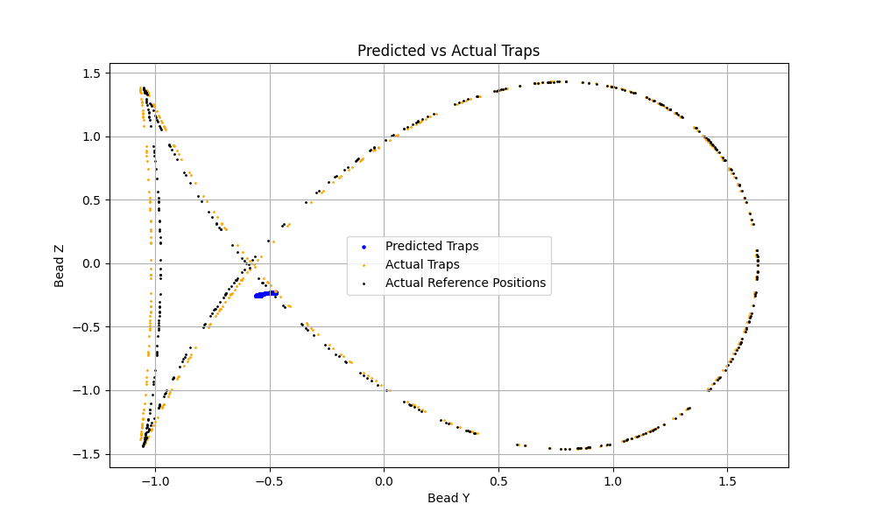
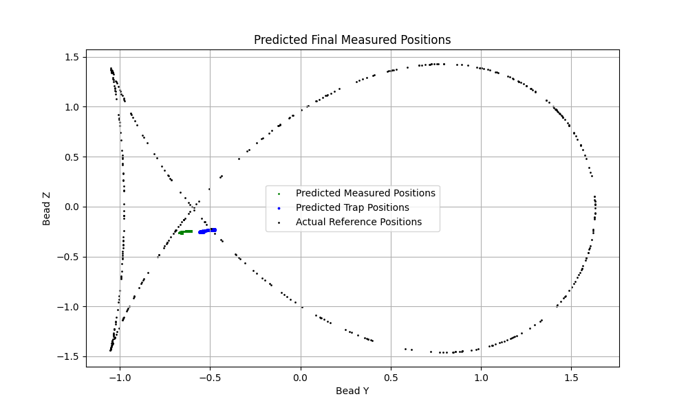
SCALED STATIC THETA STATIC REFERENCE MODEL
Predicted Traps
Predicted Measured points
R²
MSE
MAE
-0.200
1.2090
0.9249
R²
MSE
MAE
-9459.869
1.2822
0.9293

Slide 18
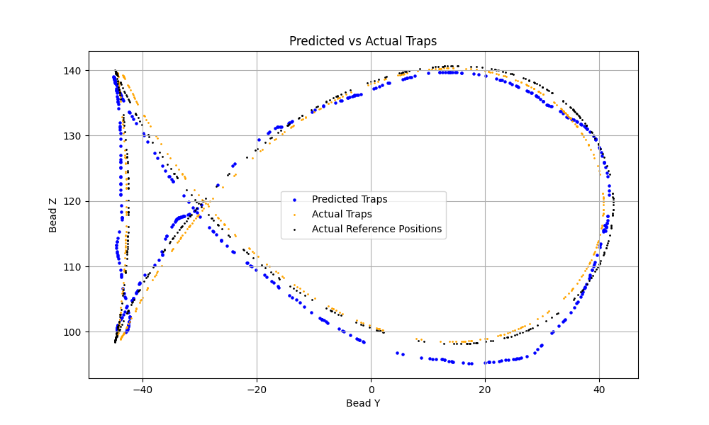
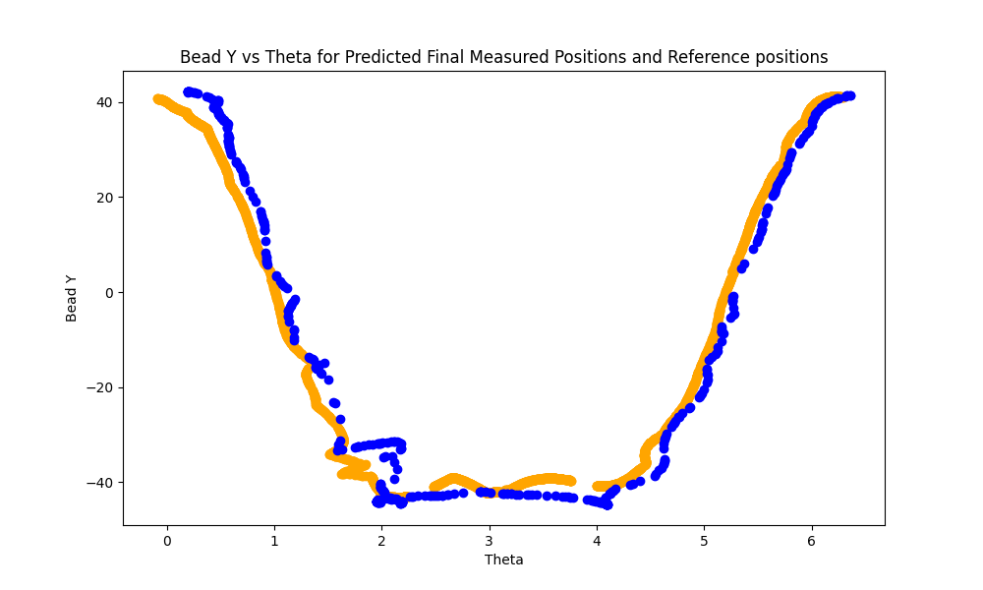
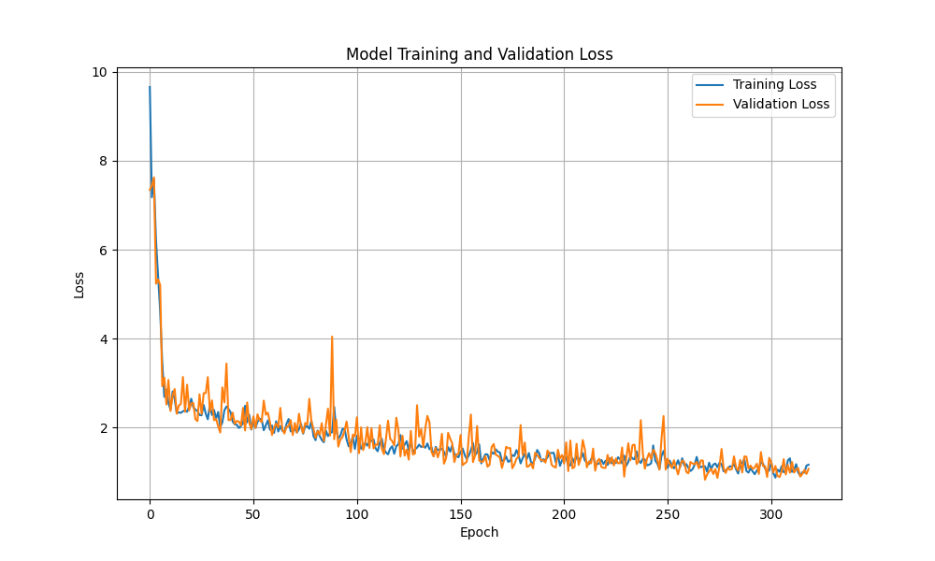
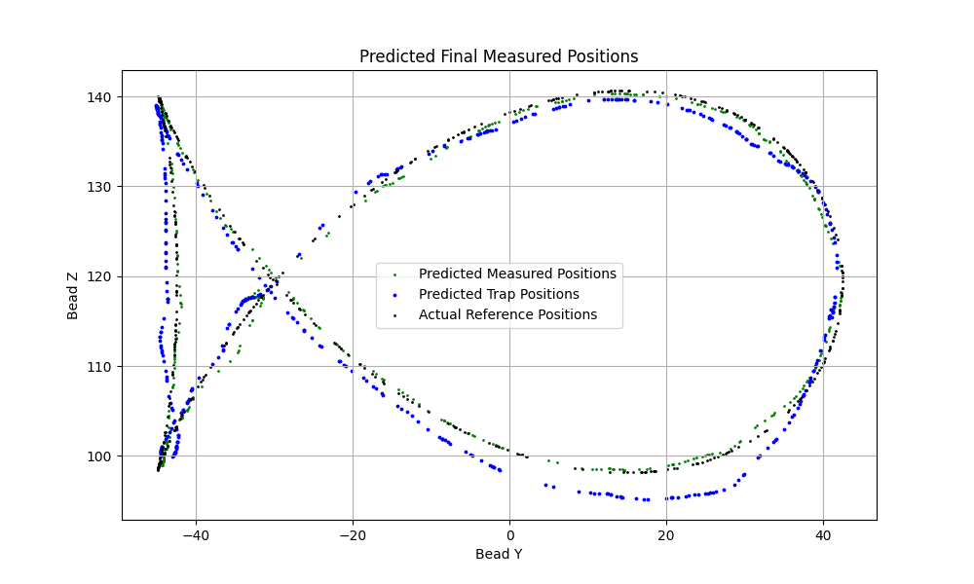
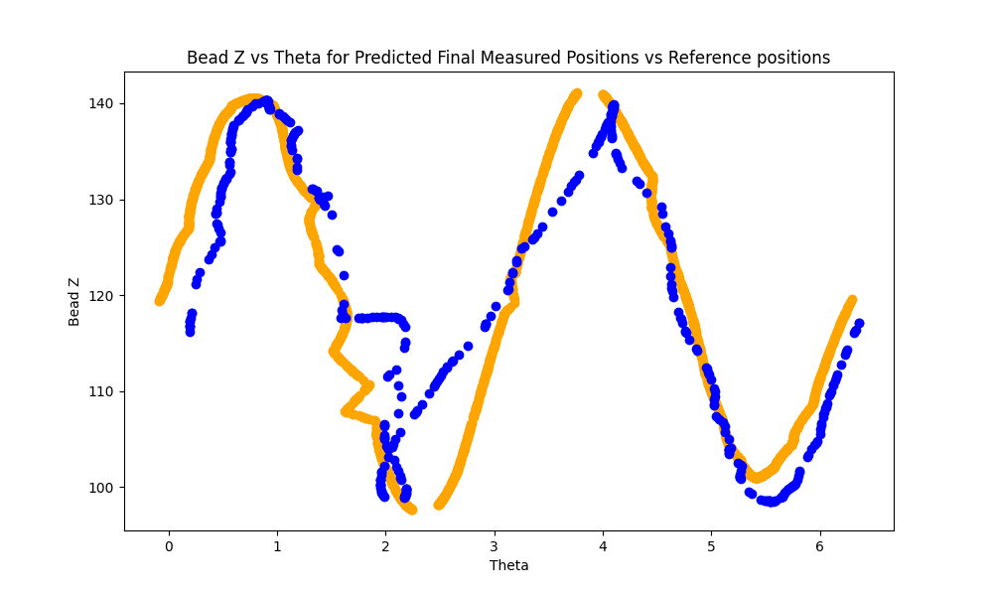
STATIC THETA DYNAMIC REFERENCE MODEL (STDR)
Predicted Traps
Predicted Measured points
0.9812
7.2205
2.1084
R²
MSE
MAE
1.8439
6.3234
1.8439

Slide 19
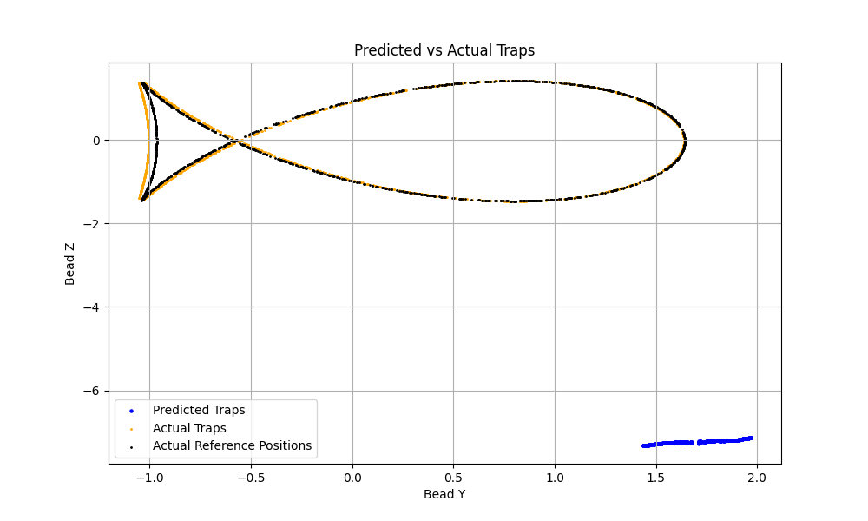
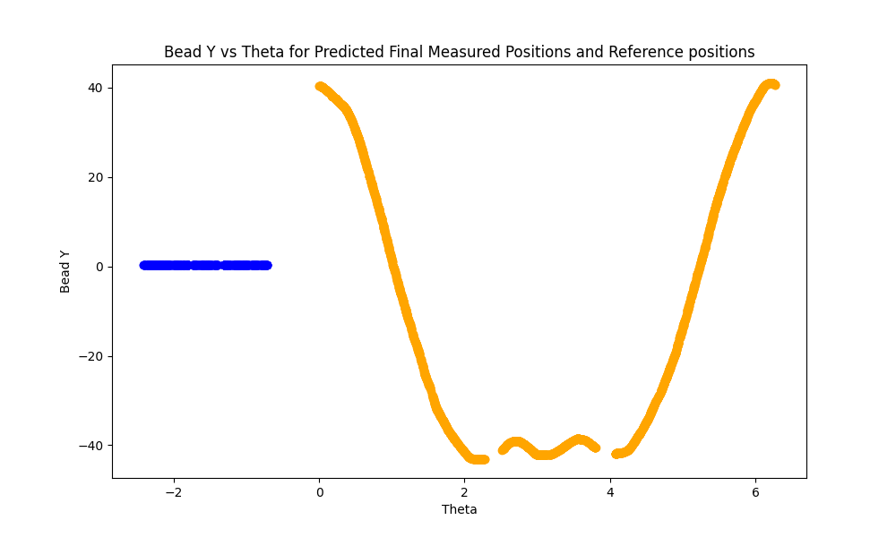
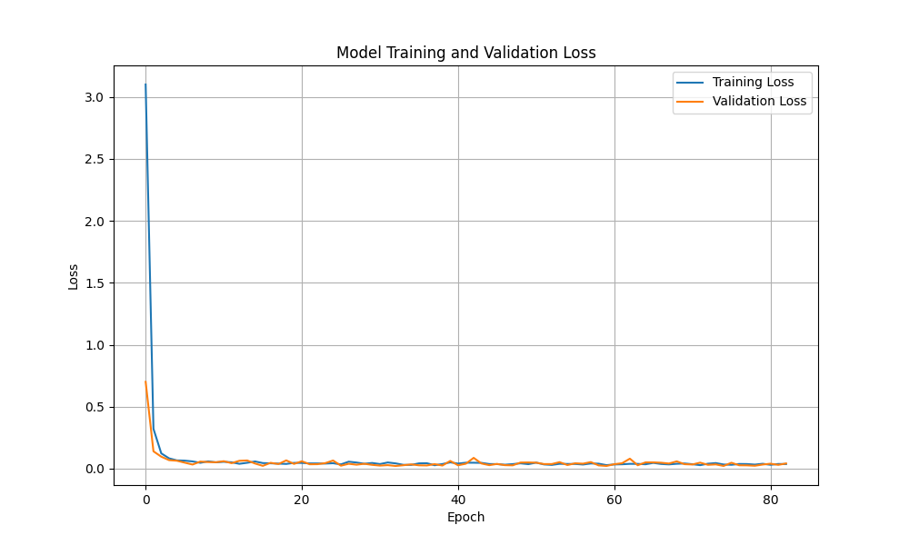
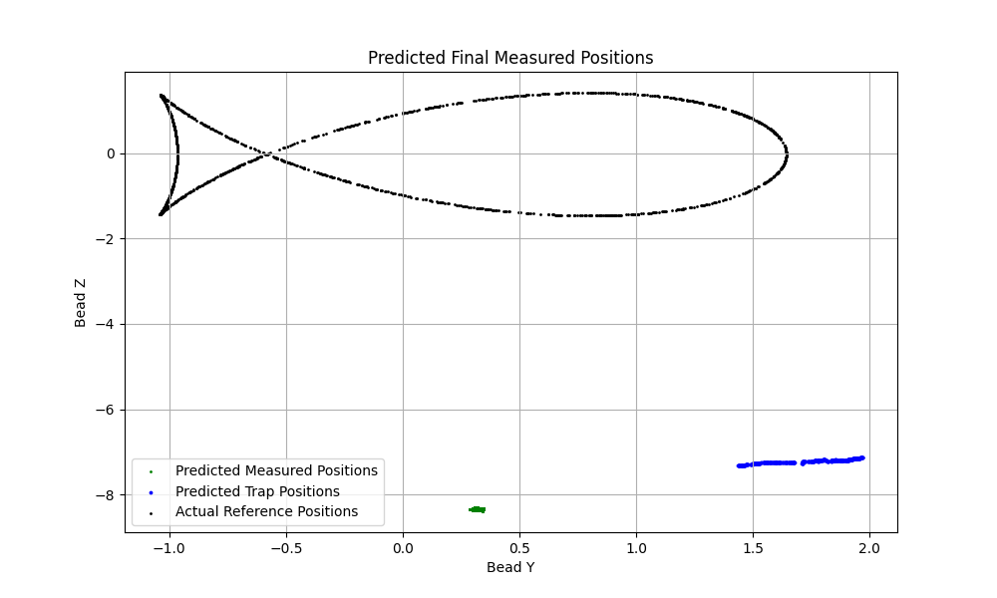
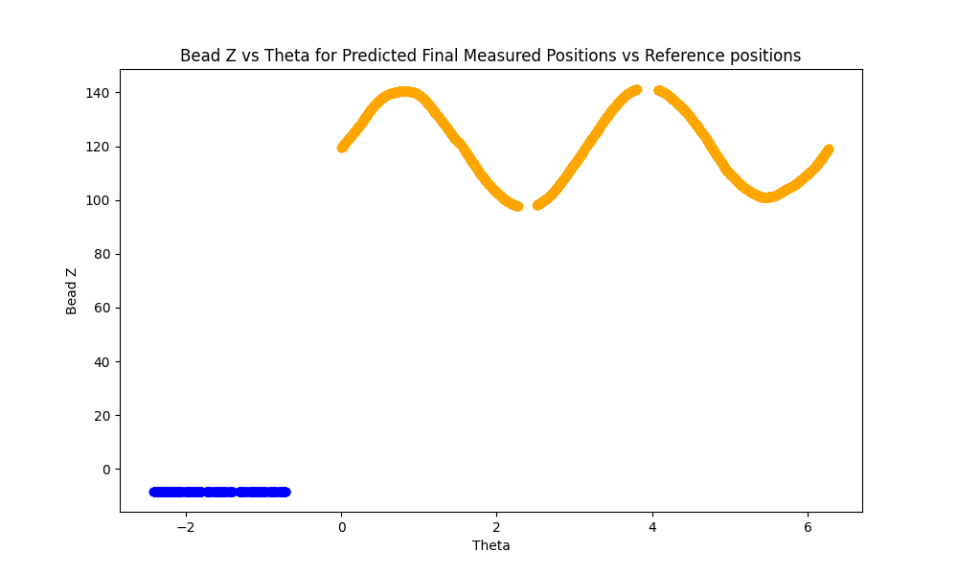
SCALED STATIC THETA DYNAMIC REFERENCE MODEL
Predicted Traps
Predicted Measured points
-30.0483
30.9216
4.7311
R²
MSE
MAE
-48750.67
35.981
4.6688

Slide 20
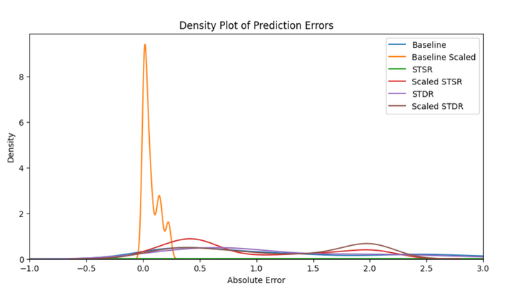
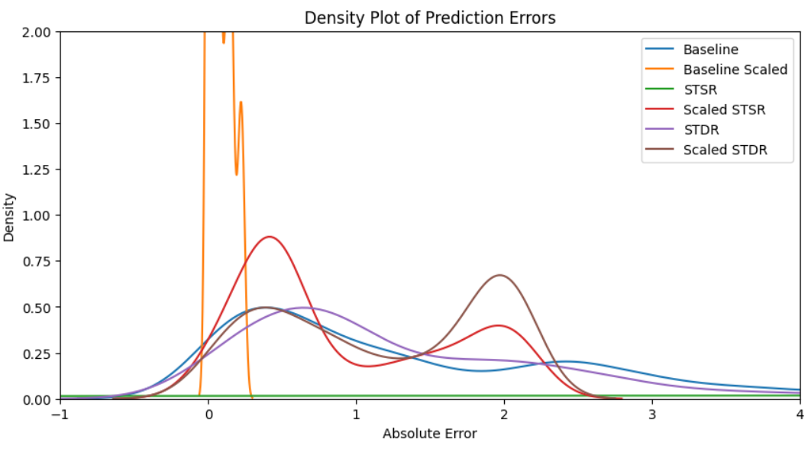
MODEL performance INSIGHTS
Model Interpretations
Best Model:
Baseline Scaled Model
Worst Model:
Static Theta Static Reference (STSR) Model
Zoomed in

Slide 21

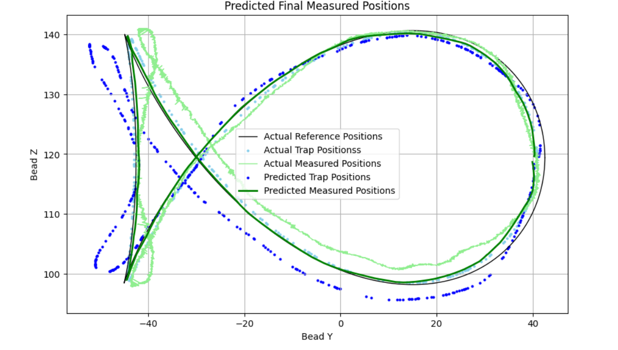

Slide 22
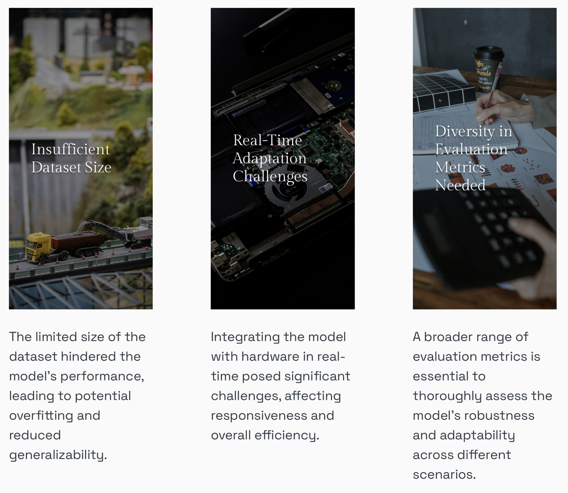
RESEARCH CONSTRAINTS
Limitations of the Study
Understanding the Constraints Affecting Research Outcomes

Slide 23

FUTURE RESEARCH FOCUS
Future Work
Identifying Key Areas for Future Research in Model Development
Model Generalization.
Integrating and validating the model performance on the hardware setup.

Slide 24
Summary of Findings:
Null hypothesis (H0) is rejected based on improved performance.
Research hypothesis (H1) is supported by significant improvements in accuracy.
Effectiveness of scaling in minimising the deviations in both Model 1 and Model 2.
Model 2, the Scaled Baseline Model and the Baseline Model
Contributions to the field:
Enhanced Prediction Accuracy.
Optimization Techniques.
Advancement in Data Acquisition and Pre-Processing.
Conclusion
Summarizing Key Contributions and Future Implications in Acoustophoretic Displays

Slide 25


Questions
Thank You

